Slide 1
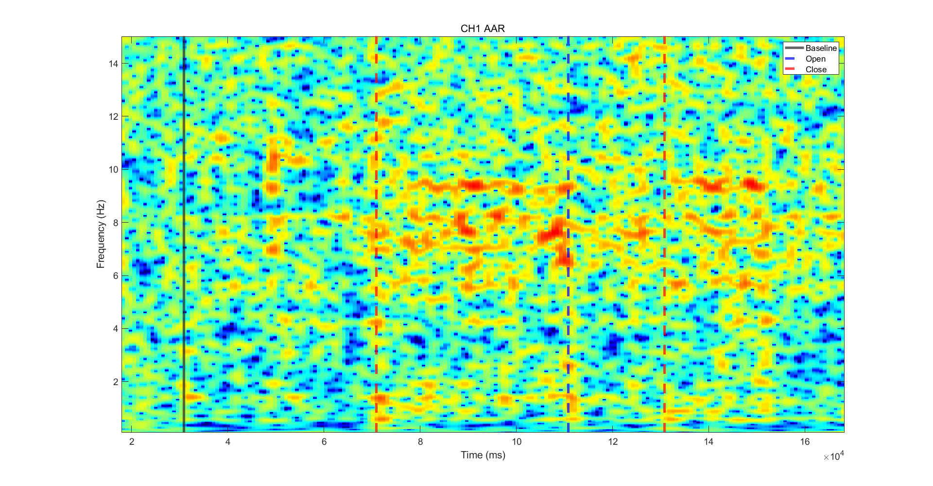

EEG Recording - AAR
AAR HPF 0.3Hz

Slide 2
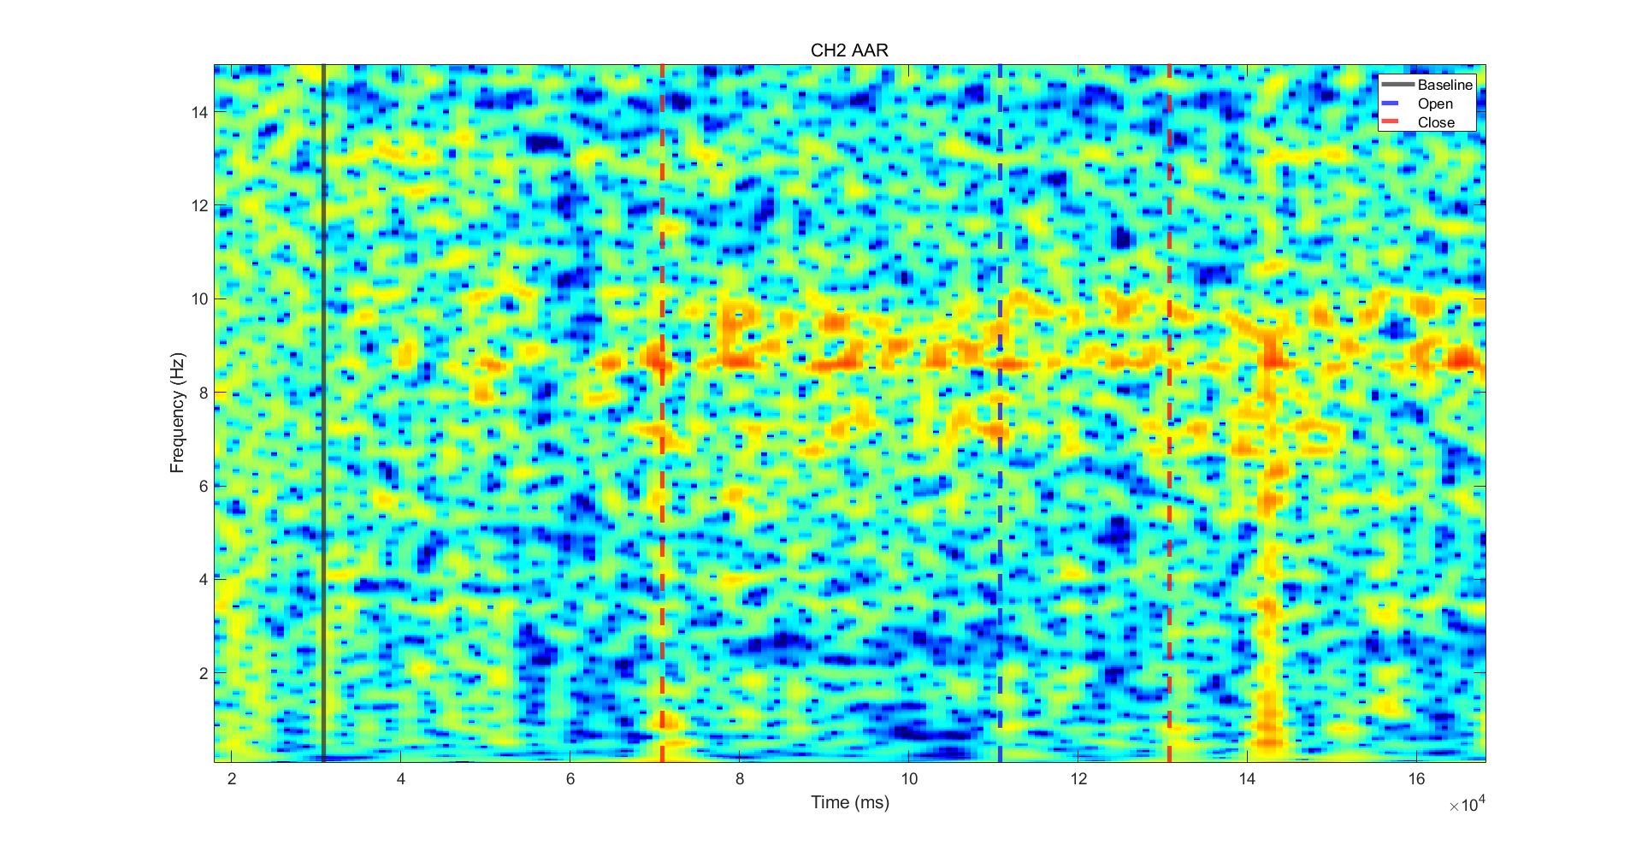
EEG Recording - AAR
AAR HPF 0.3Hz

Slide 3
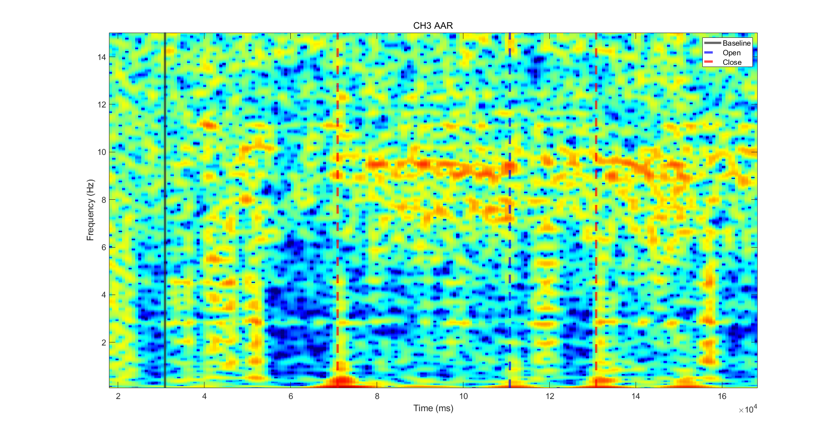
EEG Recording - AAR
AAR HPF 0.3Hz

Slide 4
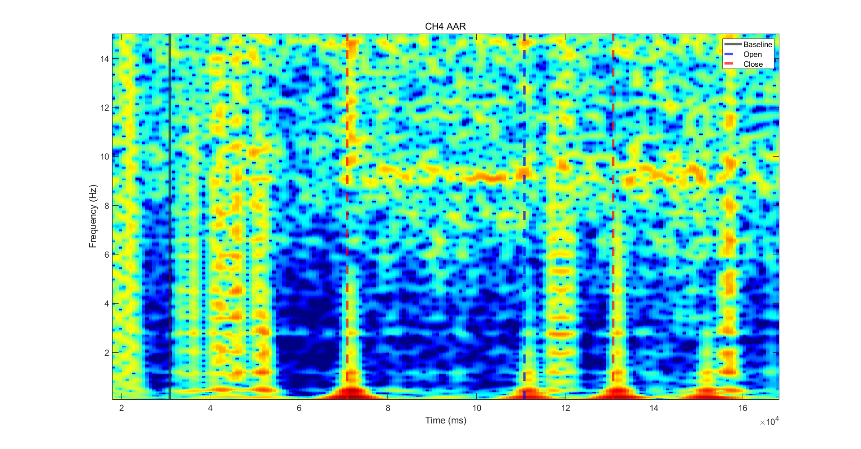
EEG Recording - AAR
AAR HPF 0.3Hz

Slide 5
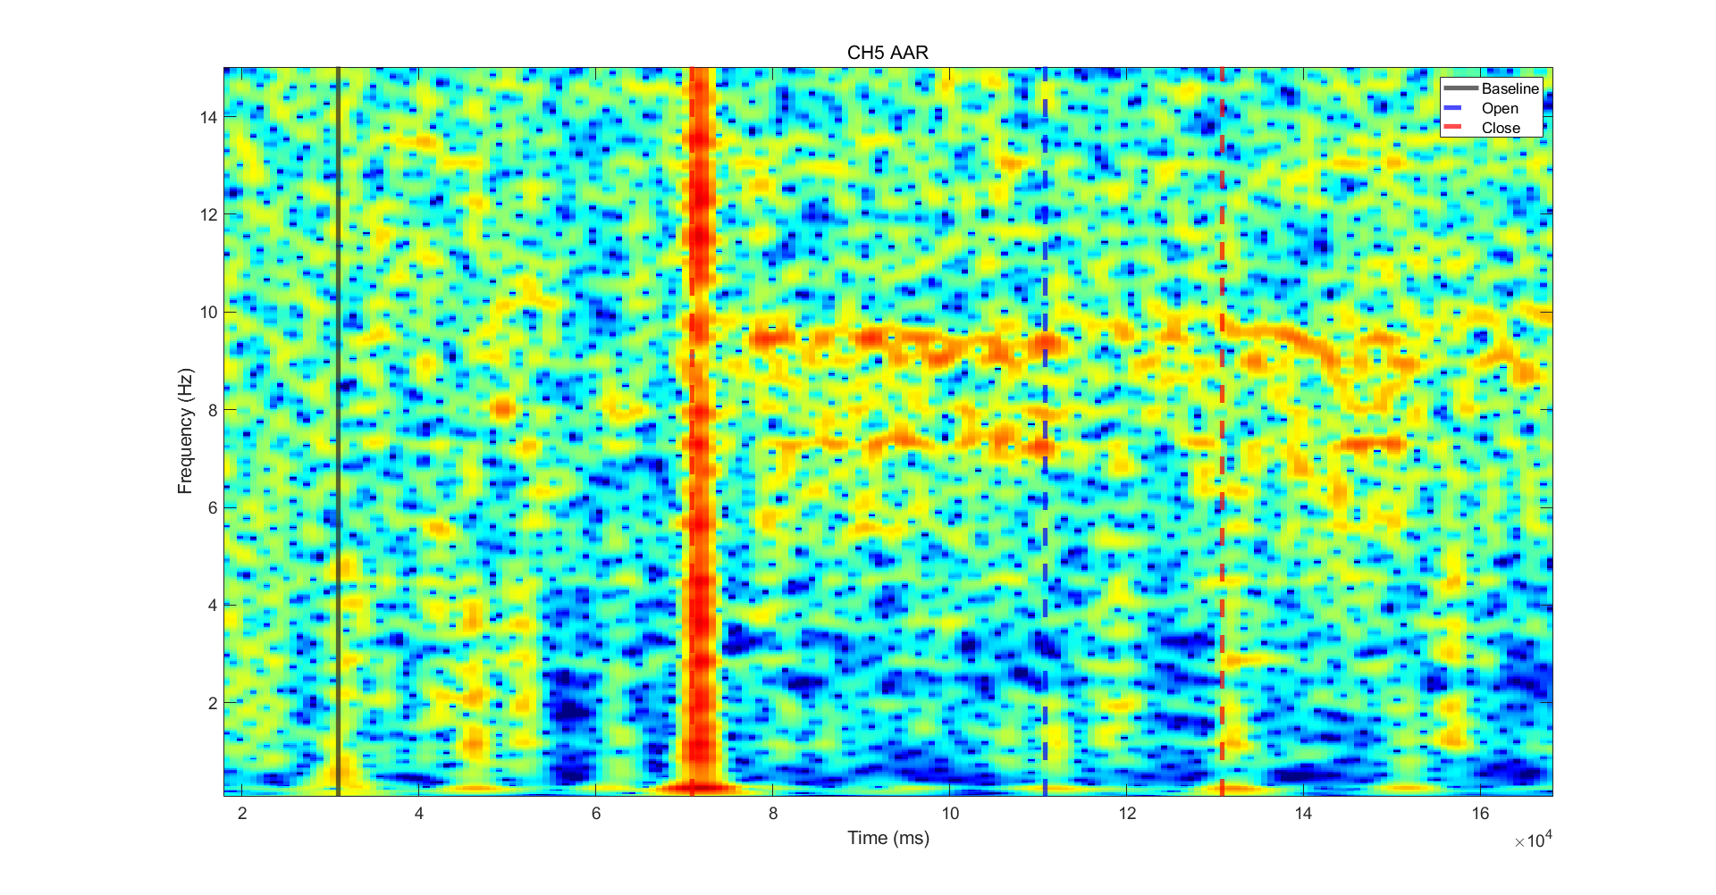
EEG Recording - AAR
AAR HPF 0.3Hz

Slide 6
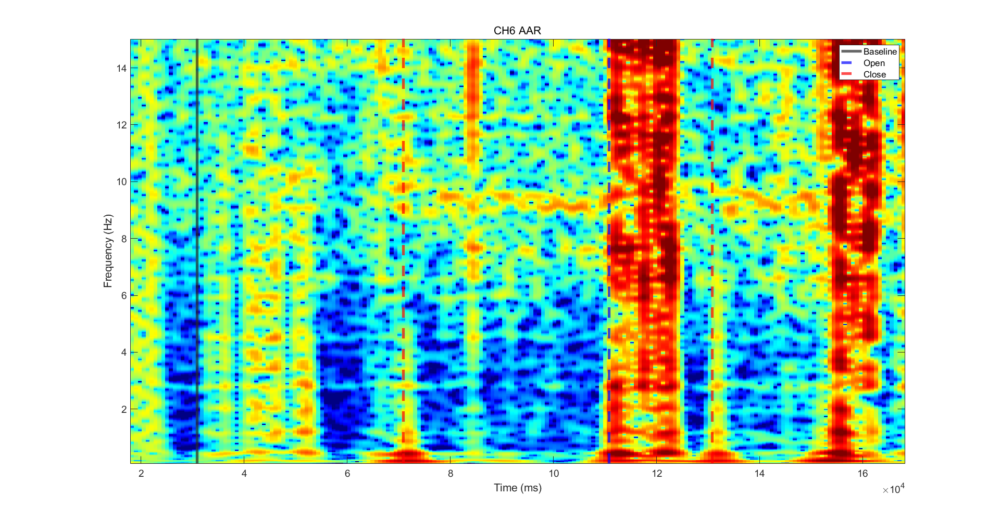
EEG Recording - AAR
AAR HPF 0.3Hz

Slide 7
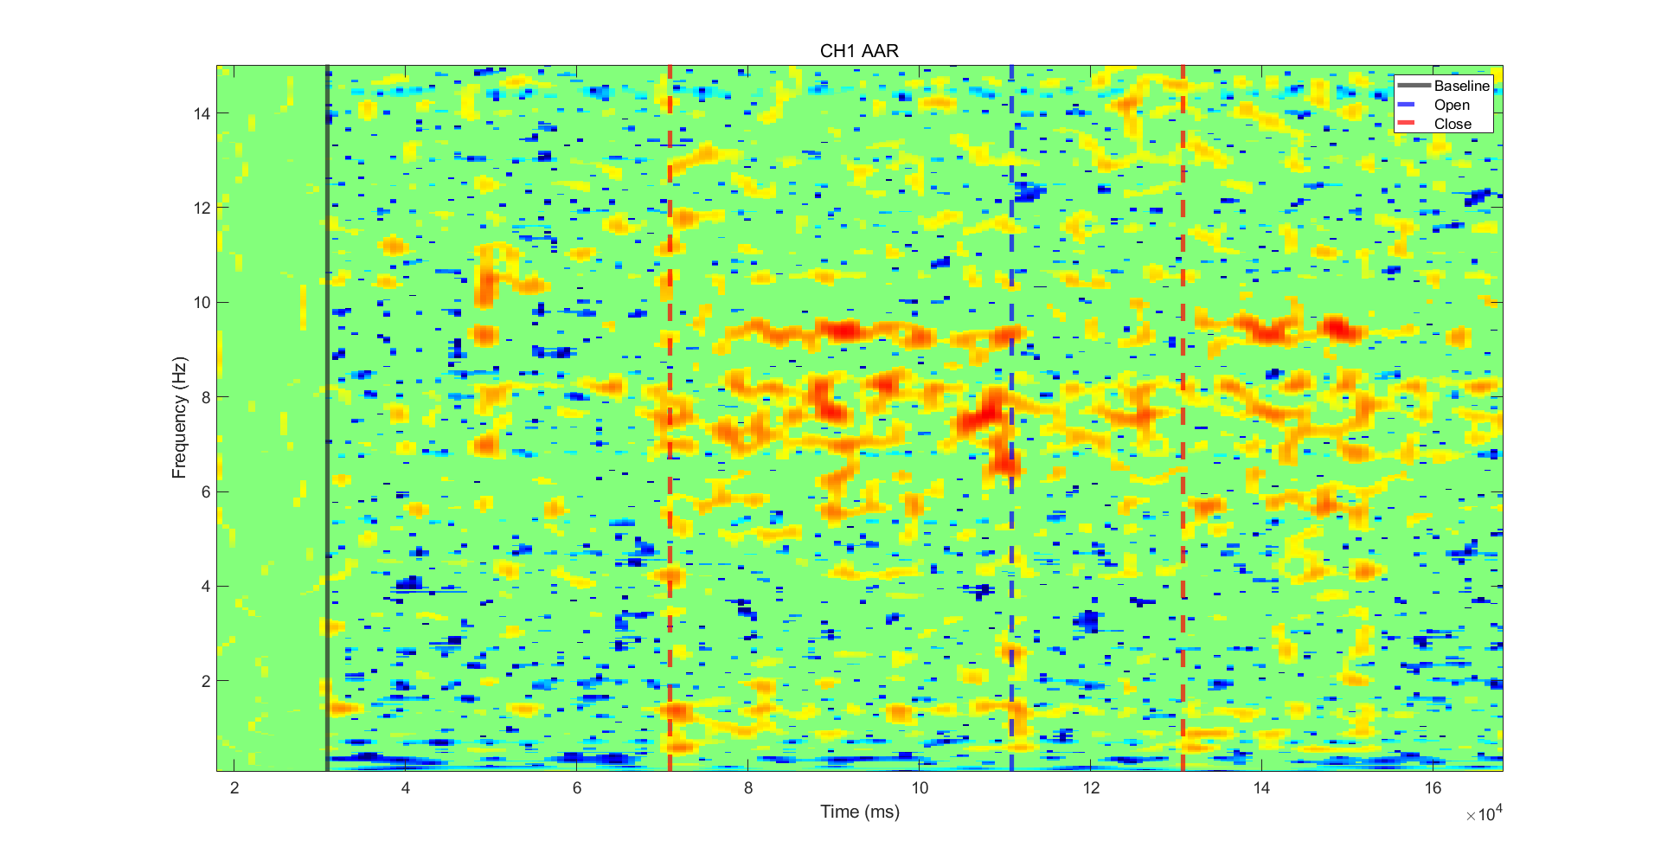
EEG Recording - AAR
AAR FDR p=0.05

Slide 8
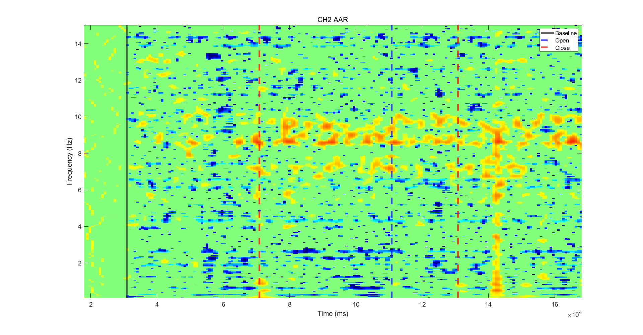
EEG Recording - AAR
AAR FDR p=0.05

Slide 9
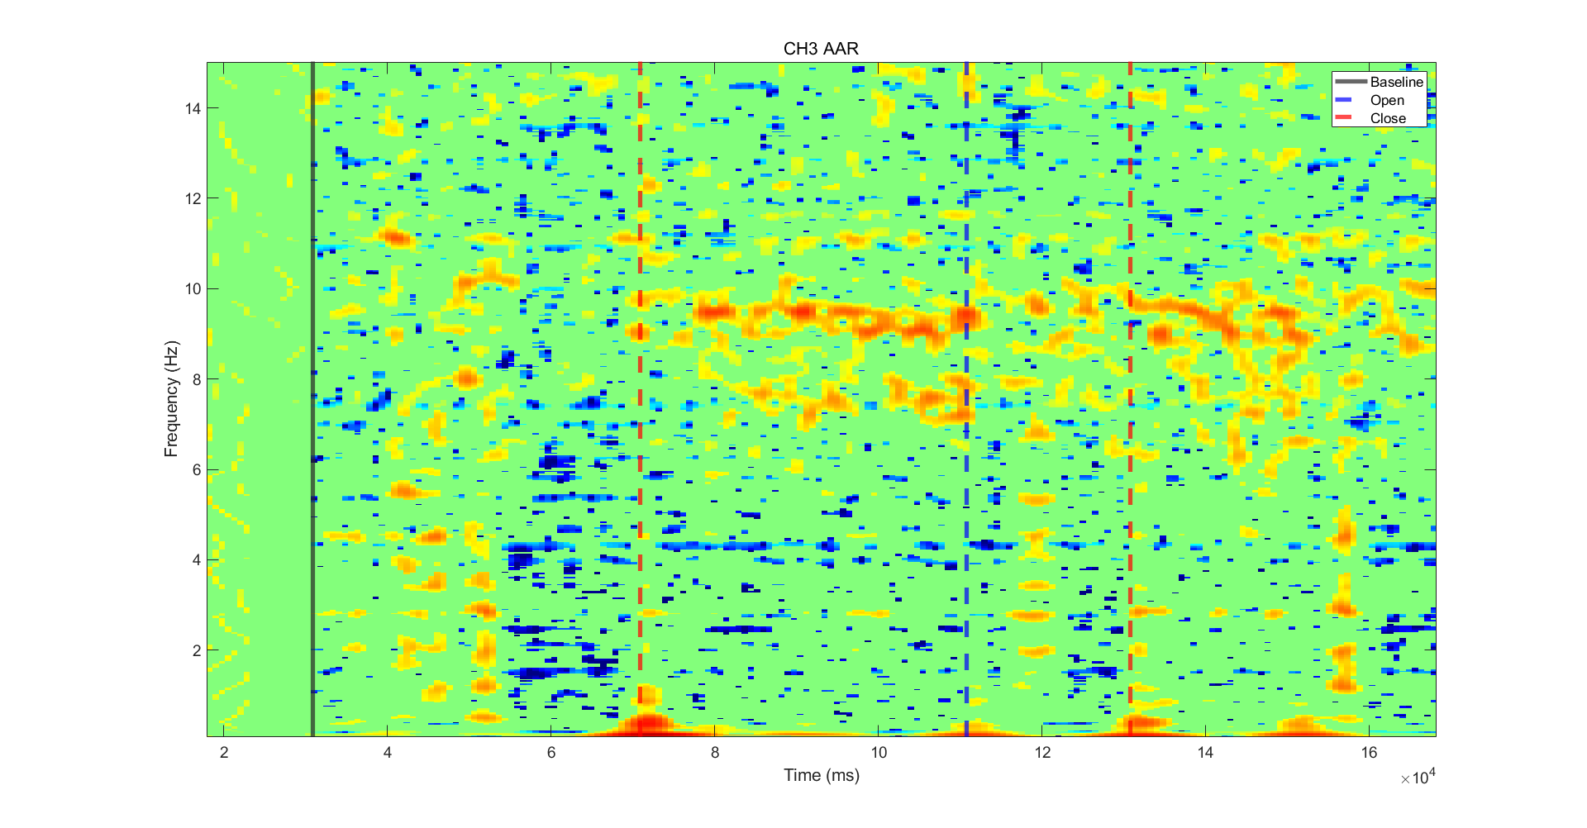
EEG Recording - AAR
AAR FDR p=0.05

Slide 10
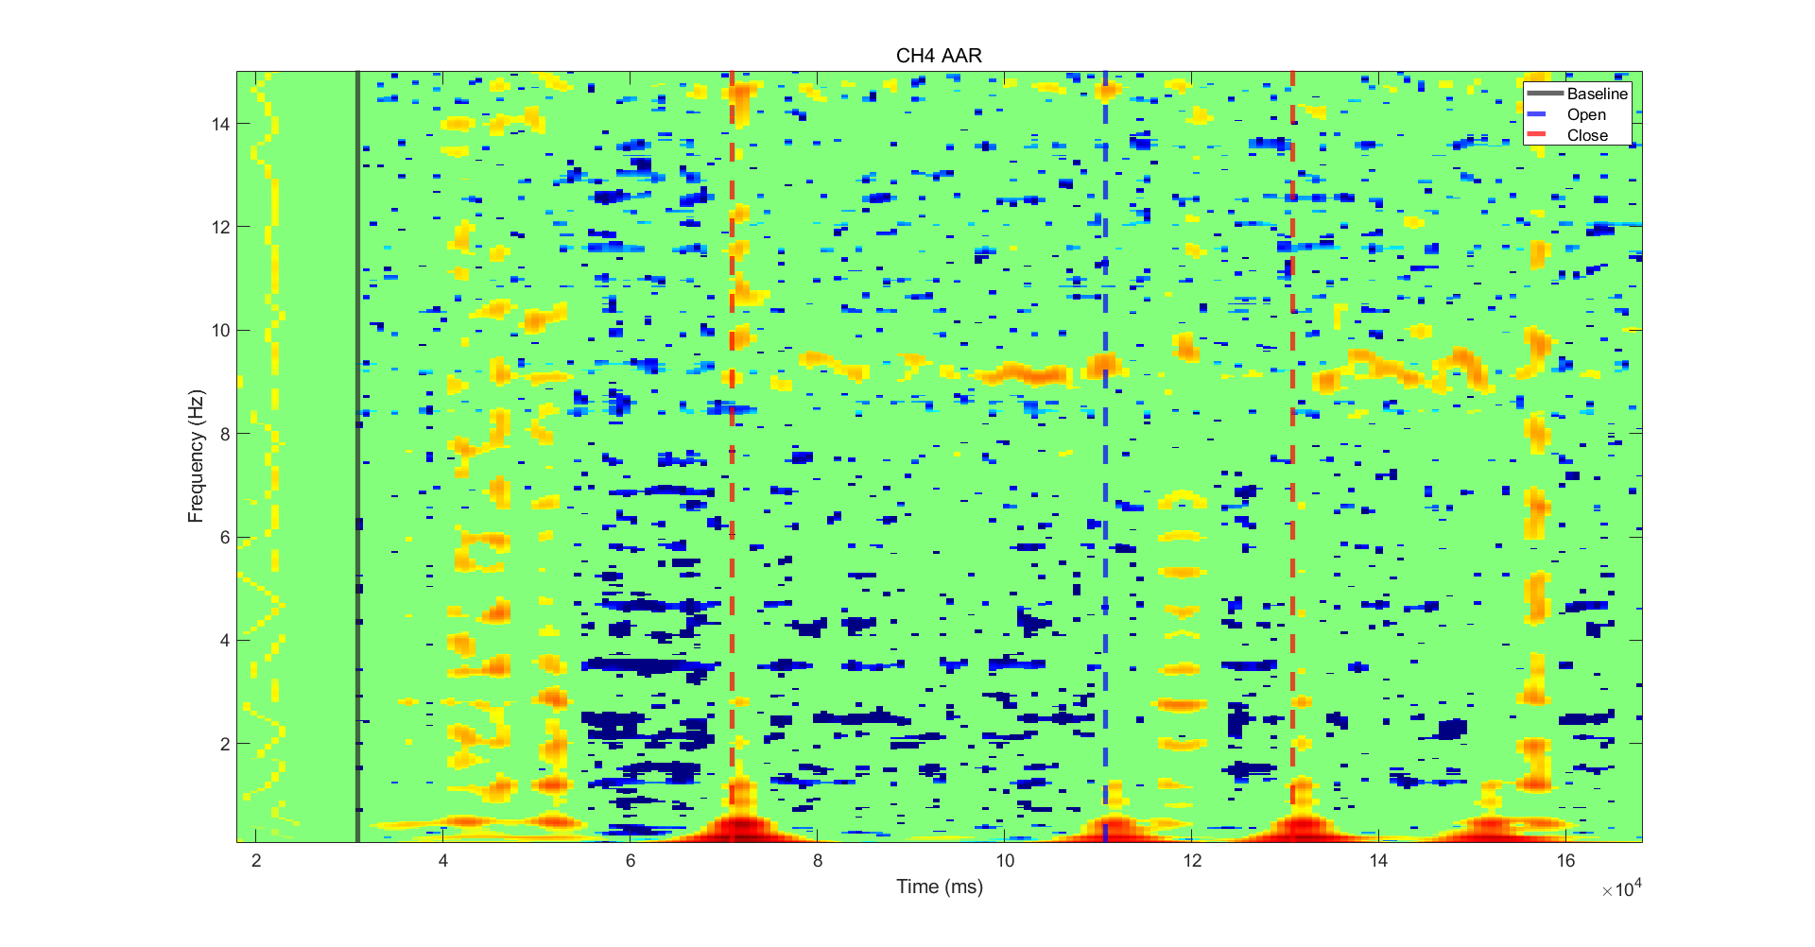
EEG Recording - AAR
AAR FDR p=0.05

Slide 11
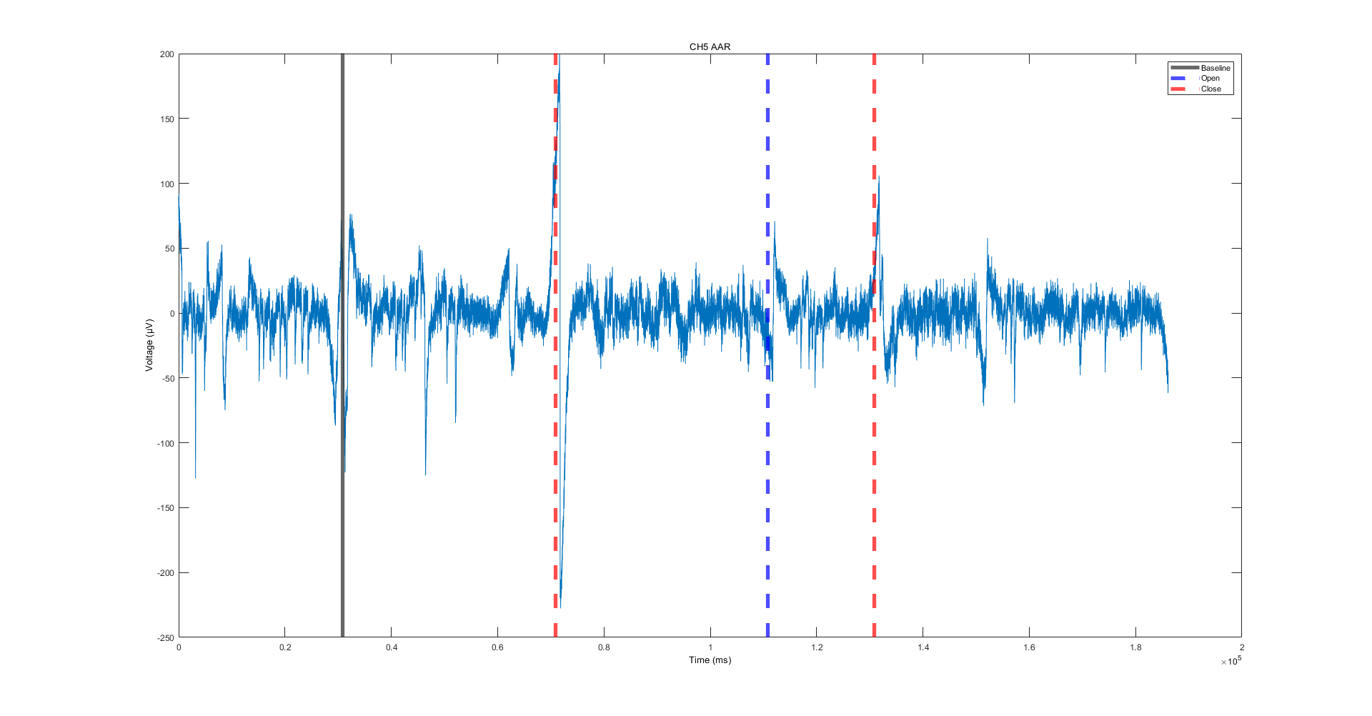
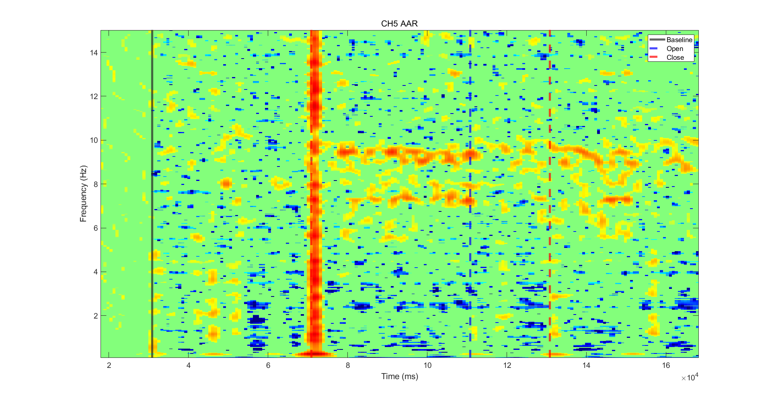
EEG Recording - AAR
AAR FDR p=0.05

Slide 12
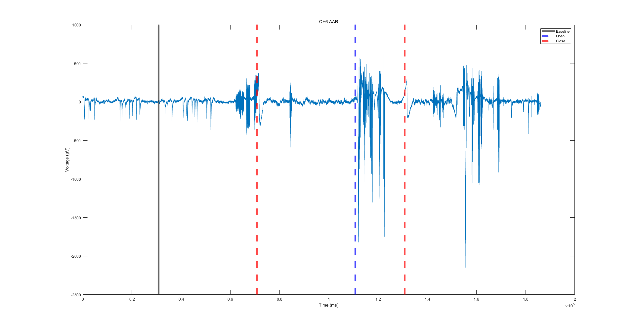
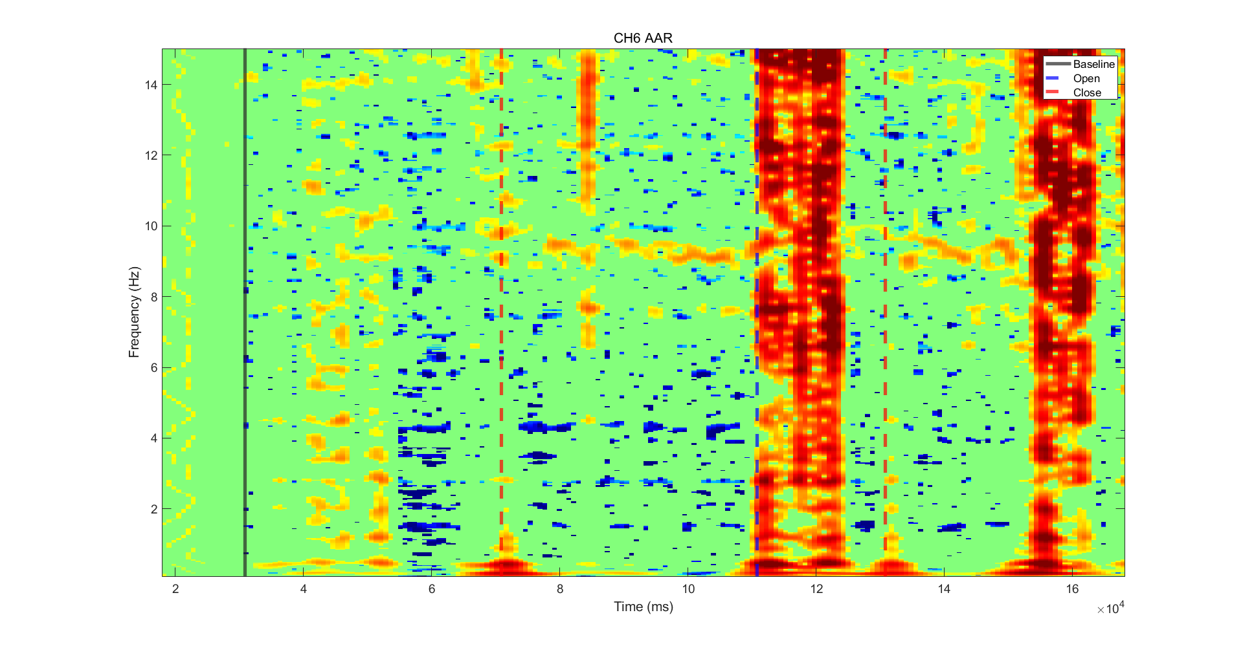
EEG Recording - AAR
AAR FDR p=0.05

